Slide 1
Introduction to Clustering
Hongyu Guo
2023

Slide 2
Clustering (Unsupervised Learning)
< x , x , … x >
Given: Examples:
Find: A natural clustering (grouping) of the data
Example Applications:
Identify similar energy use customer profiles
<x> = time series of energy usage
Identify anomalies in user behavior for computer security
<x> = sequences of user commands
1
2
n
n
Notes:
When we don’t have labels (I.e., f) we have an unsupervised learning problem.
We can apply clustering to
Find the prototypes in our data – for example to find similar customers
Find the large groups of similar observations to identify deviations/anomalies/outliers.

Slide 3
Why cluster?
Labeling is expensive
Gain insight into the structure of the data
Find prototypes in the data
Notes:
Until now we have assumed that the training data is labeled.
Now we look at what can we do with data when we have not labels.
\item Example: group customer behavior, find similar buying patterns.

Slide 4
Goal of Clustering
Given a set of data points, each described by a set of attributes, find clusters such that:
Inter-cluster similarity is
maximized
Intra-cluster similarity is
minimized
Requires the definition of a similarity measure
F1
x
x
x
x
x
x
x
x
xx
x
x
x
x
x
x
xx
x
F2
Notes:
Data

Slide 5
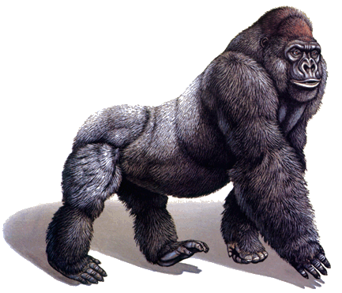
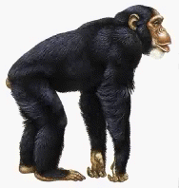
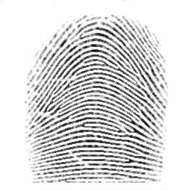
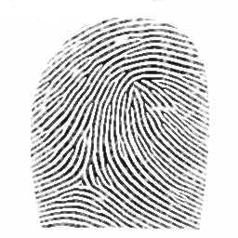
Defining Distance Measures
Slide from Eamonn Keogh
Definition: Let O₁ and O₂ be two objects from the universe of possible objects. The distance (dissimilarity) between O₁ and O₂ is a real number denoted by D(O₁,O₂)
Peter
Piotr
0.23
3
342.7

Slide 6
Slide based on one by Eamonn Keogh
What properties should a distance measure have?
D(A,B) = D(B,A) Symmetry
D(A,A) = 0 Constancy of Self-Similarity
D(A,B) = 0 iif A= B Positivity (Separation)
D(A,B) ≤ D(A,C) + D(B,C) Triangular Inequality

Slide 7
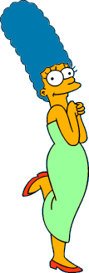
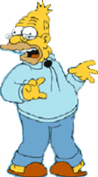
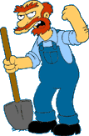





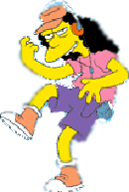
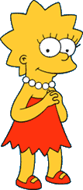

Two Types of Clustering
Slide based on one by Eamonn Keogh
Partitional algorithms: Construct various partitions and then evaluate them by some criterion
Hierarchical algorithms: Create a hierarchical decomposition of the set of objects using some criterion
Hierarchical
Partitional
Notes:
Have class break into groups and invent clustering algorithms.

Slide 8
Dendogram: A Useful Tool for Summarizing Similarity Measurements
Slide based on one by Eamonn Keogh
The similarity between two objects in a dendrogram is represented as the height of the lowest internal node they share.

Slide 9
Hierarchical Clustering
Slide based on one by Eamonn Keogh
The number of dendrograms with n leafs = (2n -3)!/[(2^{(n -2)}) (n -2)!]
Number Number of Possible
of Leafs Dendrograms
2 1
3 3
4 15
5 105
... …
34,459,425
Since we cannot test all possible trees we will have to heuristic search of all possible trees. We could do this..
Bottom-Up (agglomerative): Starting with each item in its own cluster, find the best pair to merge into a new cluster. Repeat until all clusters are fused together.
Top-Down (divisive): Starting with all the data in a single cluster, consider every possible way to divide the cluster into two. Choose the best division and recursively operate on both sides.

Slide 10


Slide based on one by Eamonn Keogh
We begin with a distance matrix which contains the distances between every pair of objects in our database.
0
8
8
7
7
0
2
4
4
D( , ) = 8
D( , ) = 1
0
3
3
0
1
0

Slide 11
Bottom-Up (agglomerative): Starting with each item in its own cluster, find the best pair to merge into a new cluster. Repeat until all clusters are fused together.
This slide and next 4 based on slides by Eamonn Keogh
Consider all possible merges…
Choose the best
…

Slide 12
Bottom-Up (agglomerative): Starting with each item in its own cluster, find the best pair to merge into a new cluster. Repeat until all clusters are fused together.
Consider all possible merges…
Choose the best
…
Consider all possible merges…
Choose the best
…

Slide 13
Bottom-Up (agglomerative): Starting with each item in its own cluster, find the best pair to merge into a new cluster. Repeat until all clusters are fused together.
Consider all possible merges…
Choose the best
…
Consider all possible merges…
Choose the best
…
Consider all possible merges…
Choose the best
…

Slide 14
Bottom-Up (agglomerative): Starting with each item in its own cluster, find the best pair to merge into a new cluster. Repeat until all clusters are fused together.
Consider all possible merges…
Choose the best
…
Consider all possible merges…
Choose the best
…
Consider all possible merges…
Choose the best
…

Slide 15
Slide based on one by Eamonn Keogh
We know how to measure the distance between two objects, but defining the distance between an object and a cluster, or defining the distance between two clusters is non obvious.
Single linkage (nearest neighbor): In this method the distance between two clusters is determined by the distance of the two closest objects (nearest neighbors) in the different clusters.
Complete linkage (furthest neighbor): In this method, the distances between clusters are determined by the greatest distance between any two objects in the different clusters (i.e., by the "furthest neighbors").
Group average linkage: In this method, the distance between two clusters is calculated as the average distance between all pairs of objects in the two different clusters.

Slide 16
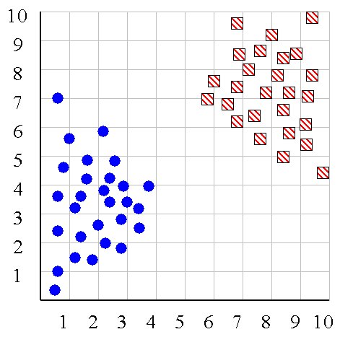
Slide based on one by Eamonn Keogh
Single linkage
Average linkage

Slide 17
Slide based on one by Eamonn Keogh
Hierarchal Clustering Methods Summary
No need to specify the number of clusters in advance
Hierarchal nature maps nicely onto human intuition for some domains
They do not scale well: time complexity of at least O(n²), where n is the number of total objects
Like any heuristic search algorithms, local optima are a problem
Interpretation of results is (very) subjective

Slide 18







Slide based on one by Eamonn Keogh
Partitional Clustering
Nonhierarchical, each instance is placed in exactly one of K non-overlapping clusters.
Since only one set of clusters is output, the user normally has to input the desired number of clusters K.

Slide 19
Slide based on one by Eamonn Keogh
Partition Algorithm 1: k-means
1. Decide on a value for k.
2. Initialize the k cluster centers (randomly, if necessary).
3. Decide the class memberships of the N objects by assigning them to the nearest cluster center.
4. Re-estimate the k cluster centers, by assuming the memberships found above are correct.
5. If none of the N objects changed membership in the last iteration, exit. Otherwise goto 3.

Slide 20
K-means Clustering
Demo:
https://user.ceng.metu.edu.tr/~akifakkus/courses/ceng574/k-means/

Slide 21
What Is K-Means Clustering?
K-means clustering is a method for grouping n observations into K clusters.
It uses vector quantization and aims to assign each observation to the cluster with the nearest mean or centroid, which serves as a prototype for the cluster.
Originally developed for signal processing, K-means clustering is now widely used in machine learning to partition data points into K clusters based on their similarity.
The goal is to minimize the sum of squared distances between the data points and their corresponding cluster centroids, resulting in clusters that are internally homogeneous and distinct from each other.

Slide 22
K-means Clustering
Strengths
Simple iterative method
User provides “K”
Weaknesses
Often too simple → bad results
Difficult to guess the correct “K”

Slide 23
K-means Clustering
Basic Algorithm:
Step 0: select K
Step 1: randomly select initial cluster seeds
Seed 1 650
Seed 2 200

Slide 24
K-means Clustering
An initial cluster seed represents the “mean value” of its cluster.
In the preceding figure:
Cluster seed 1 = 650
Cluster seed 2 = 200

Slide 25
K-means Clustering
Step 2: calculate distance from each object to each cluster seed.
What type of distance should we use?
Squared Euclidean distance
Step 3: Assign each object to the closest cluster

Slide 26
K-means Clustering
Seed 1
Seed 2

Slide 27
K-means Clustering
Step 4: Compute the new centroid for each cluster
Cluster Seed 1 708.9
Cluster Seed 2 214.2

Slide 28
K-means Clustering
Iterate:
Calculate distance from objects to cluster centroids.
Assign objects to closest cluster
Recalculate new centroids
the mean of all the variables within the cluster
Stop based on convergence criteria
Centroids of newly formed clusters do not change
Points remain in the same cluster
Maximum number of iterations is reached
Notes:
Step 1: Partition the items into K initial clusters.
Step 2: Scan through the list of n items, assigning each item to the cluster whose centroid (mean) is closest. Each time an item is reassigned, we recalculate the cluster mean or centroid for the cluster receiving that item and the cluster losing that item.
Step 3: Repeat Step 2 over and over again until no more reassignments are made.

Slide 29
K-means Issues
Distance measure is squared Euclidean
Scale should be similar in all dimensions
Rescale data?
Not good for nominal data. Why?
Approach tries to minimize the within-cluster sum of squared error (WCSS)
Implicit assumption that SSE is similar for each group

Slide 30
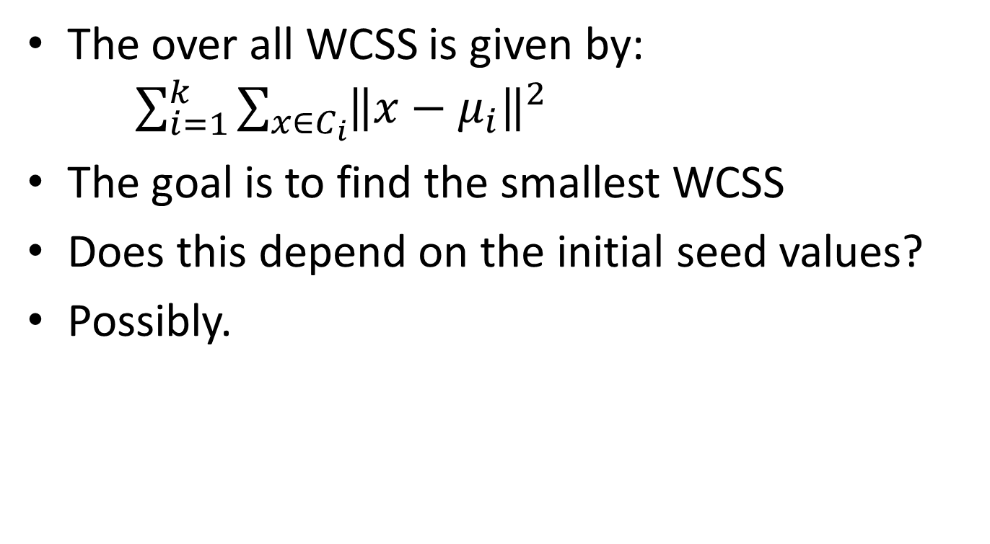
WCSS
The over all WCSS is given by: $\sum_{i=1}^{k}{\sum_{x∈C_{i}}{{\left\|x−μ_{i}\right\|}^{2}}}$
The goal is to find the smallest WCSS
Does this depend on the initial seed values?
Possibly.

Slide 31
To apply partitional clustering we need to:
Select features to characterize the data
Collect representative data
Choose a clustering algorithm
Specify the number of clusters

Slide 32
Um, what about k?
Idea 1: Use our new trick of cross validation to select k
What should we optimize? SSE? Trace?
Problem?
Idea 2: Let our domain expert look at the clustering and decide if they like it
How should we show this to them?
Problem?
Idea 3: The “knee” solution

Slide 33
When k = 1, the objective function is 873.0
1
2
3
4
5
6
7
8
9
10
Slide based on one by Eamonn Keogh

Slide 34
When k = 2, the objective function is 173.1
1
2
3
4
5
6
7
8
9
10
Slide based on one by Eamonn Keogh

Slide 35
When k = 3, the objective function is 133.6
1
2
3
4
5
6
7
8
9
10
Slide based on one by Eamonn Keogh

Slide 36
We can plot the objective function values for k equals 1 to 6…
The abrupt change at k = 2, is highly suggestive of two clusters in the data. This technique for determining the number of clusters is known as “knee finding” or “elbow finding”.
1.00E+03
9.00E+02
8.00E+02
7.00E+02
6.00E+02
Objective Function
5.00E+02
4.00E+02
3.00E+02
2.00E+02
1.00E+02
0.00E+00
k
1
2
3
4
5
6
Slide based on one by Eamonn Keogh

Slide 37
Bottom Line
K-means
Easy to use
Need to know K
May need to scale data
Good initial method
Local optima
No guarantee of optimal solution
Repeat with different starting values
(for explanation of mixture models see https://www.ncbi.nlm.nih.gov/pmc/articles/PMC5096736/ )

